Slide 1
Total Internal Reflection

Slide 2

By the end of this Smart Lesson, you should be able to:
Define the terms total internal reflection and critical angle.
Draw a ray diagram showing refraction at the critical angle.
Identify when it is possible for total internal reflection to occur.

Slide 3
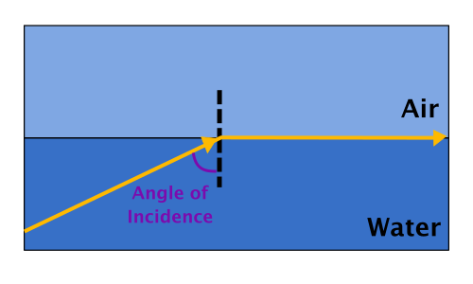
When light travels from a more dense to a less dense medium, it refracts away from the normal.
If a ray of light has a high enough angle of incidence, the refracted ray will travel along the boundary between the two media.

Slide 4
Looking at the diagram below, you can see that the angle of incidence can become even larger.
But what happens when that angle gets larger?
The light won't be able to refract because there is no way for it to pass into the other substance.

Slide 5
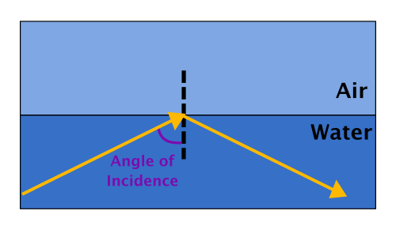
Instead, the light starts to reflect.

Slide 6
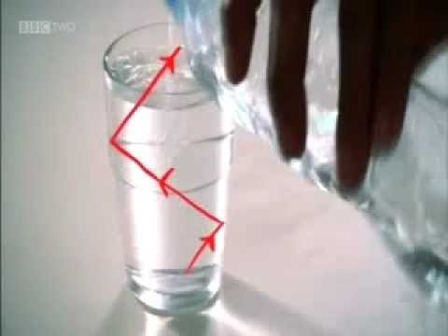
This phenomenon is known as total internal reflection.

Slide 7

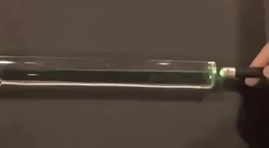
Total internal reflection occurs when the angle between the normal and the incident ray (called the angle of incidence) is greater than the critical angle.

Slide 8
The critical angle is a very important angle.
When the incident ray strikes the boundary between the two media at the critical angle, the refracted ray will run along the boundary.
When the angle of incidence is greater than the critical angle, the light will be reflected back from the boundary.

Slide 9
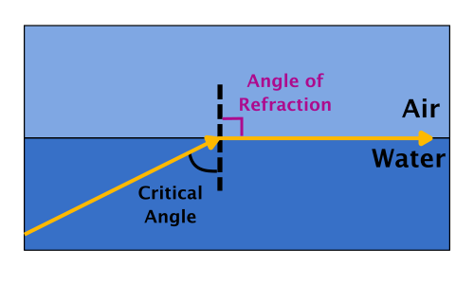
When the angle of incidence is equal to the critical angle it means that the angle of refraction is 90°.
Remember, the angle of refraction is the angle between the ray of light and the normal.

Slide 10
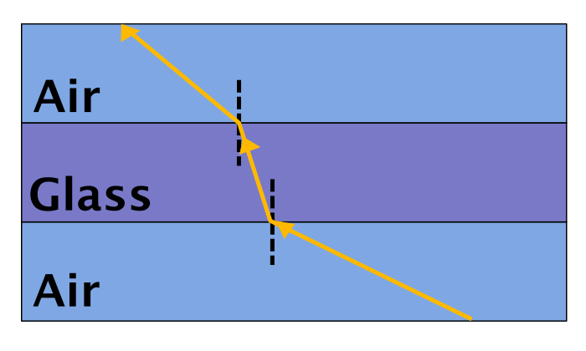
Total internal reflection can only occur when light travels into a medium with a lower refractive index.
This is because the light will bend away from the normal.
Therefore, total internal reflection could occur when light leaves glass and travels into air, but cannot occur when light leaves air and travels into glass.

